Slide 1

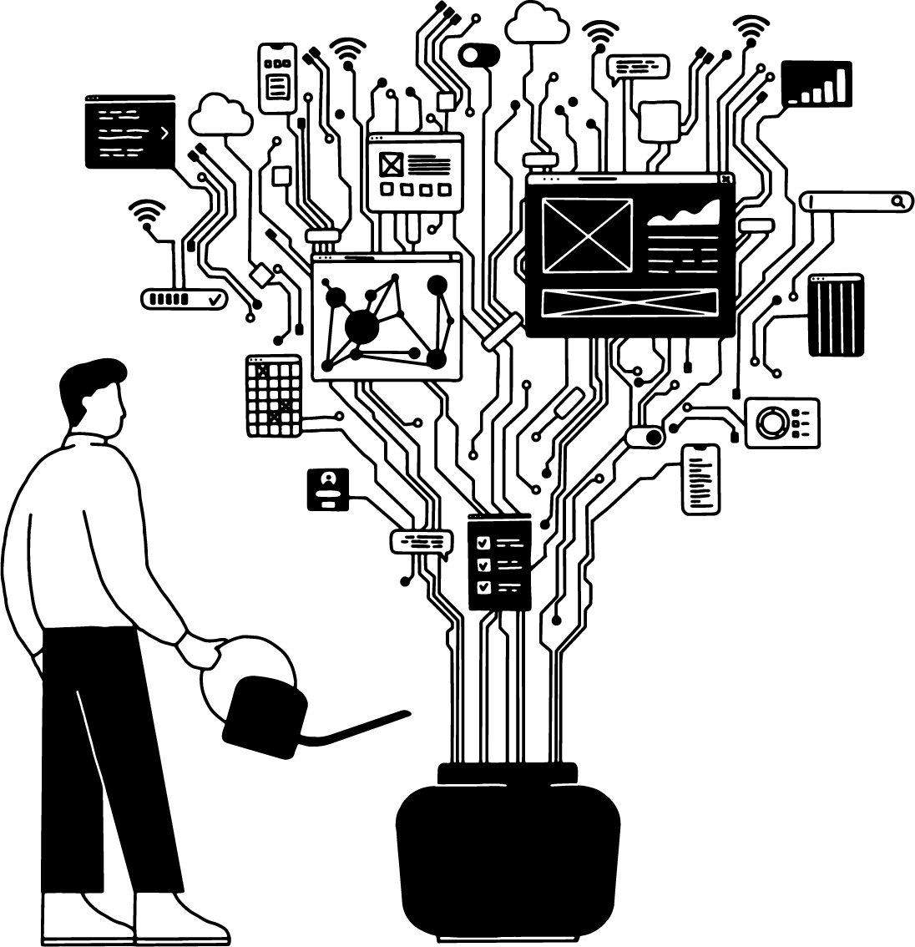
MicroPython & ESP8266
Michael Niepel

Slide 2
Micropython & ESP8266
ESP8266
Sensors MicroPython
MQTT
Basics Workshop
Notes:
Kein Entweder-oder! Software und Hardware. Code und Kultur. Hightech und Heartbeat – wir bringen Charaktere, Kompetenzen und Ansichten zusammen. Synergien statt Silos. Dieser Ansatz greift auch unser Logo auf: Die beiden Xe in unserem Namen formen ein „&“ und symbolisieren so das Zusammenbringen unterschiedlichster Variablen.

Slide 3
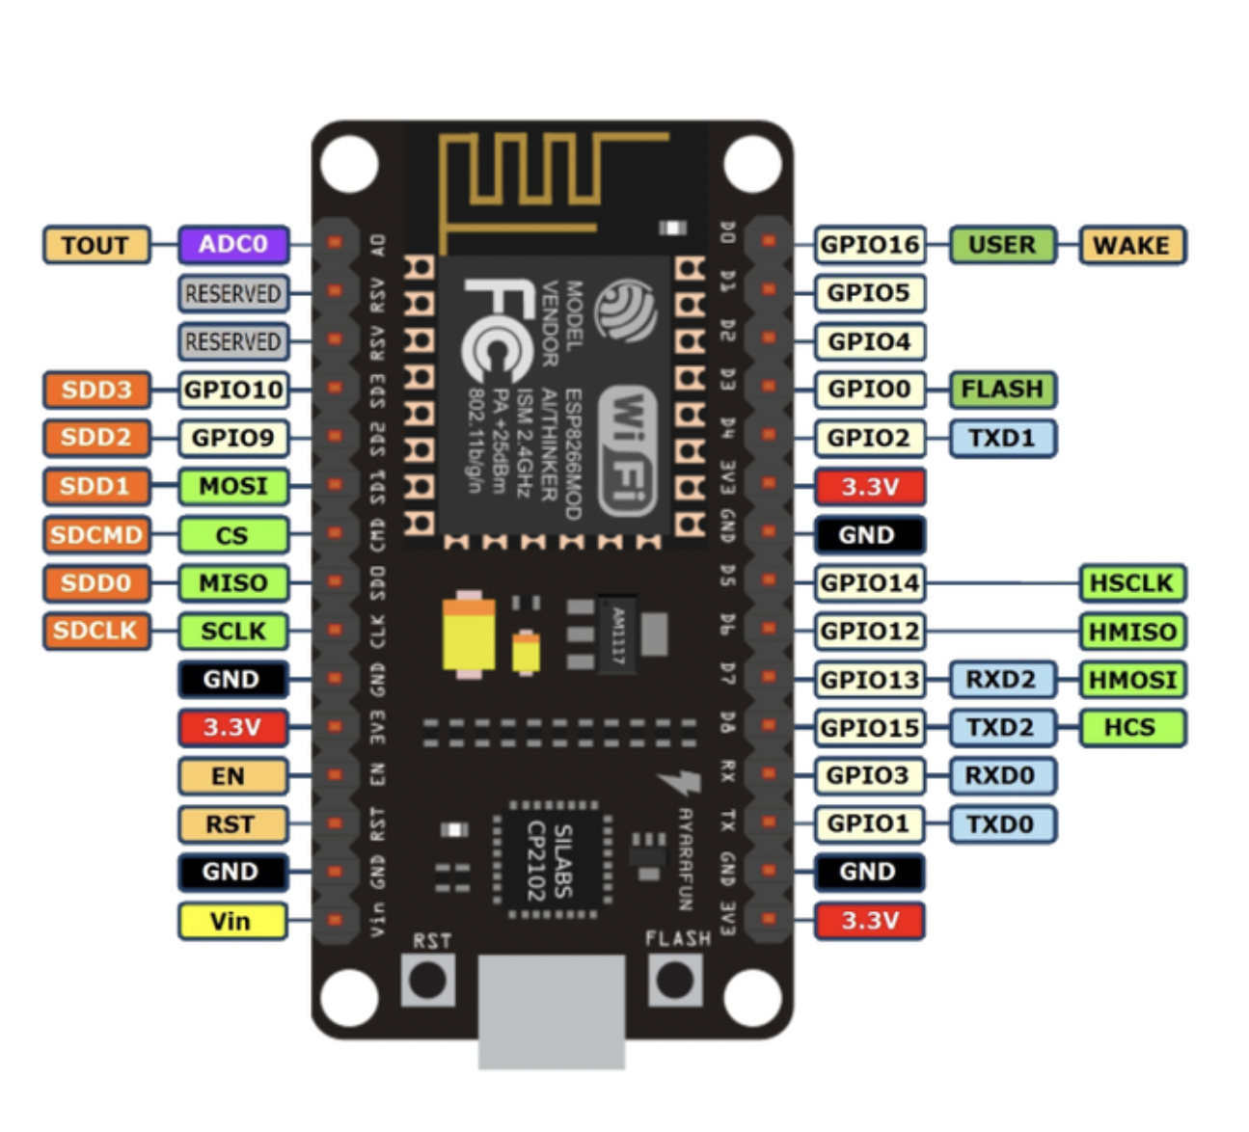
ESP8266
Cheap Wi-Fi module for IoT applications with microcontroller capability
Development board ESP-12E NodeMCU
Wi-Fi
4MB Flash
USB to Serial (UART)
11 digital I/O
1 analog input
Support for various languages
C++
JavaScript
MicroPython
Lisp

Slide 4
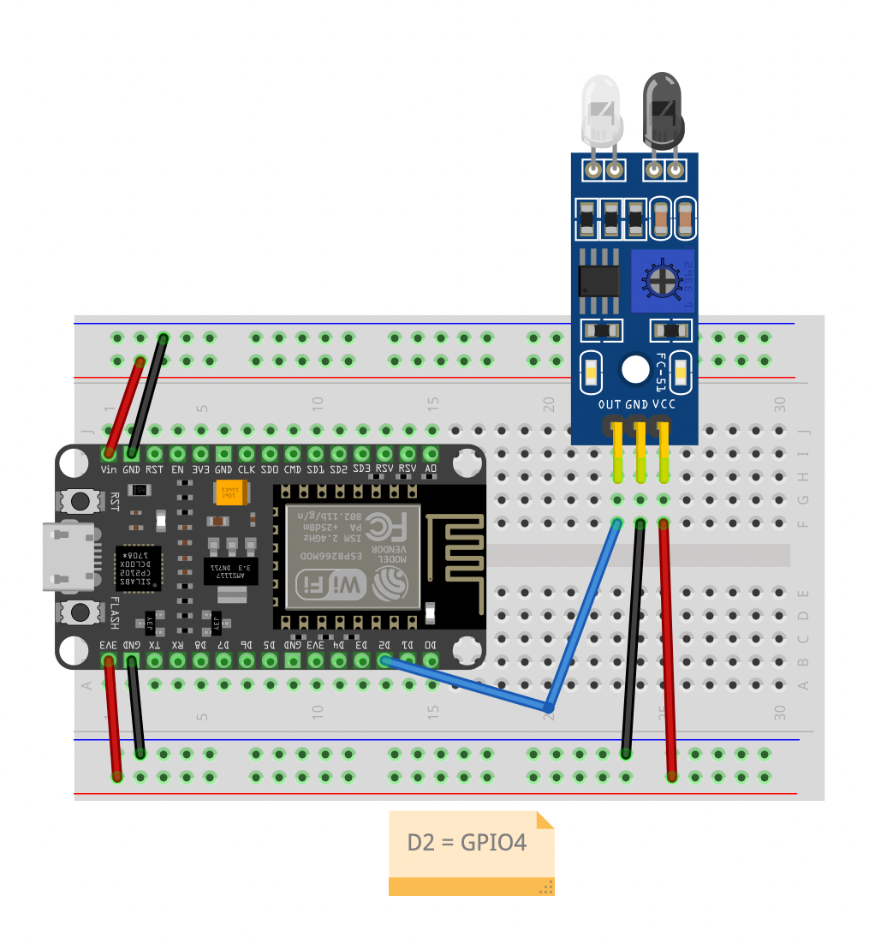
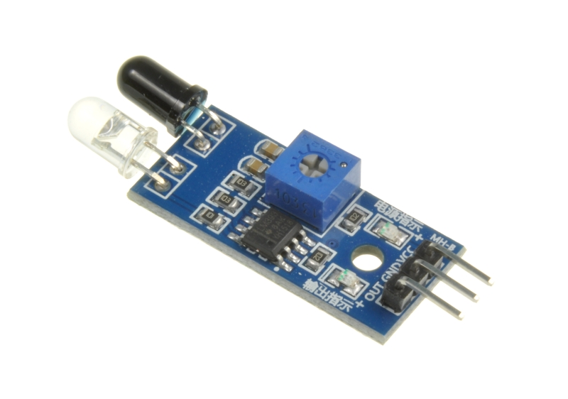
Sersors
IR optical sensor FC-51
Comparator LM393
2 - 30cm range
Input voltage 3,3 - 5V

Slide 5
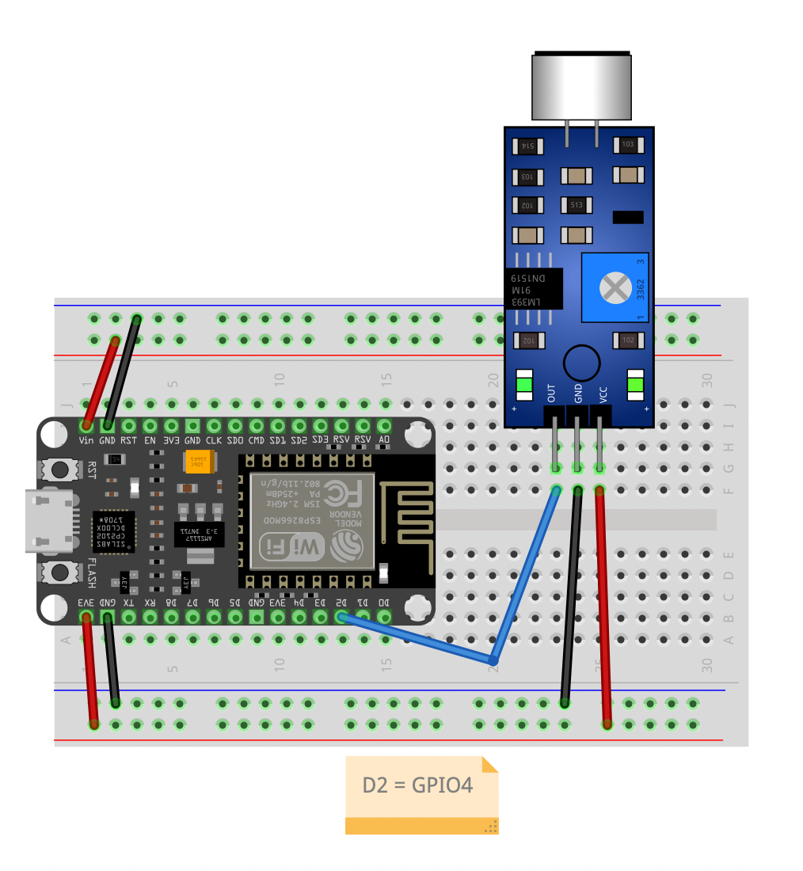
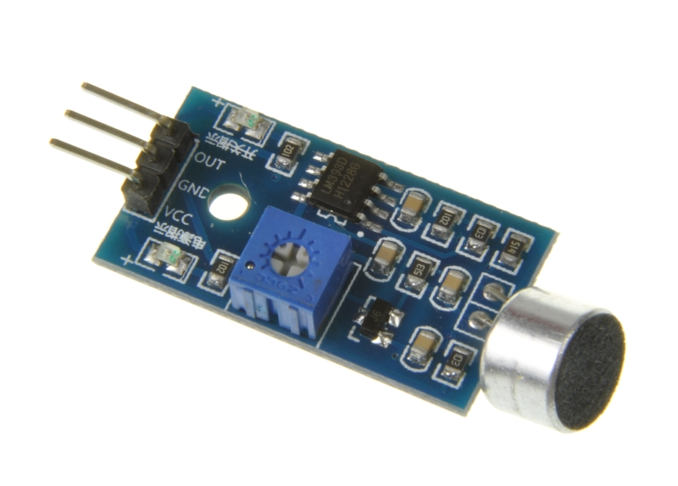
Sersors
Sound sensor
Comparator LM393
Input voltage 4 - 6V

Slide 6
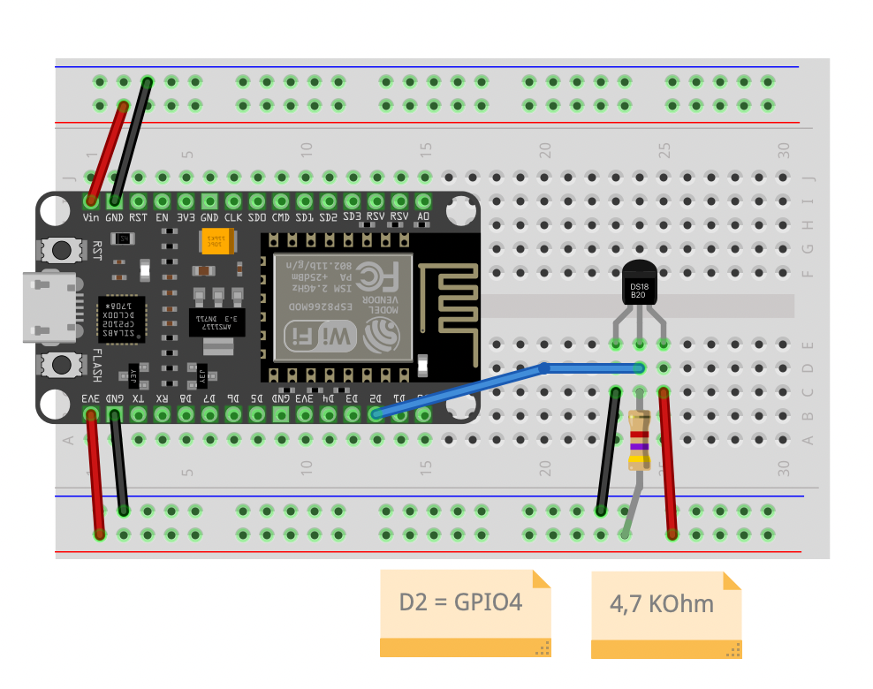
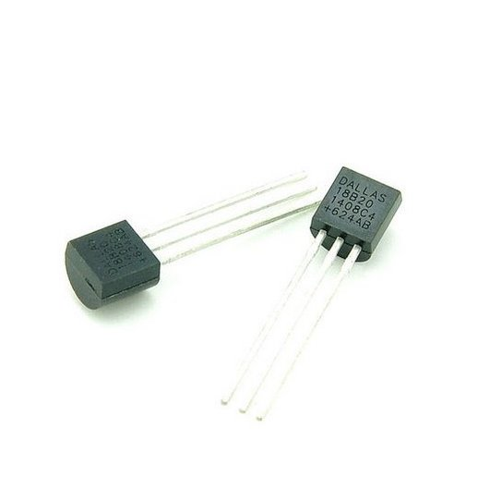
Sersors
Temperature sensor
Digital sensor
UMW DS18B20
Range: -55 to +125 °C
Input voltage 2,5 - 5,5V

Slide 7
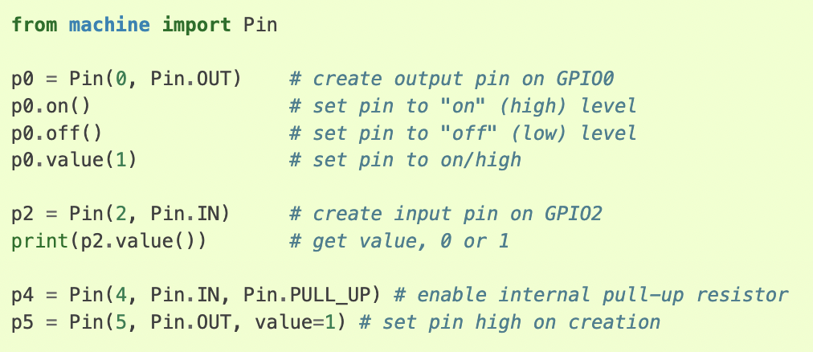
MicroPython
Python3 implementation
Subset of Python Standard Library
Optimalisation for MCU
REPL (aj WebREPL)
HW modules
machine
esp
network
onewire
neopixel
dht (temperature and humidity sensors)
ssd1306 (OLED display)
http://docs.micropython.org/en/latest/library/index.html

Slide 8
MQTT
The Standard for IoT Messaging
Message Queue Telemetry Transport
Lightweight
Publish/Subscribe
Low bandwidth
TLS encryption
OAuth authentication
Authorization

Slide 9
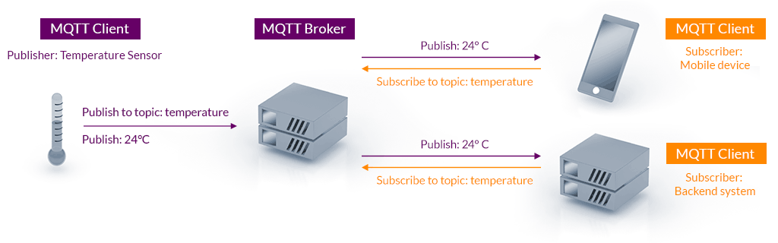
MQTT
The Standard for IoT Messaging

Slide 10
MQTT
The Standard for IoT Messaging
Servers/Brokers
RabbitMQ, HiveMQ, Mosquitto, Cassandra, …
Cloud Brokers
HiveMQ, MyQttHub, …
Client libraries
Arduino / Espduino
libemqtt, paho, mqttools, umqtt, …
Tools
MQTT Explorer

Slide 11
MQTT
Versus HTTP
 | MQTT | HTTP
Architecture | Pub - Sub | Request - Response
Command Target | Topics | URIs
Underlying protocol | TCP/IP | TCP/IP
Secure connections | TLS + username/pwd (SASL support) | TLS + username/pwd (SASL support)
Client observability | Known connection status | Unknown connection status
Messaging mode | Async, event-based | Sync
Message queuing | Broker can queue | Application needs to implement
Message overhead | 2 bytes min. Header can be binary | 8 bytes min. Header is text
Message size | 256 MB max | No limit
Content type | Binary | Text
Message distribution | One to many | One to one
Reliability (QoS) | 0 (forget), 1 (at least 1), 2 (exactly 1) | Application ahs to implement

Slide 12
MQTT
Versus HTTP Performance
 | MQTT Bytes | HTTP Bytes
Establish connection | 5572 | 2261
Disconnect | 376 (optional) | 0
For each message published | 388 | 3285
Sum for 1 message | 6336 | 5546
Sum for 10 messages | 9829 | 55,460
Sum for 100 messages | 44,748 | 554,600

Slide 13
Basics
Flash Firmware & Test Connection & Install CP2102 drivers
MicroPython firmware
https://micropython.org/download/?port=esp8266
CP210x drivers
https://www.silabs.com/developers/usb-to-uart-bridge-vcp-drivers
Esptool
pip install esptool
http://docs.micropython.org/en/latest/esp8266/tutorial/intro.html#deploying-the-firmware
Test connection over serial
picocom, minicom, screen (mac)
http://docs.micropython.org/en/latest/esp8266/tutorial/repl.html
Mu Editor
https://codewith.mu/

Slide 14
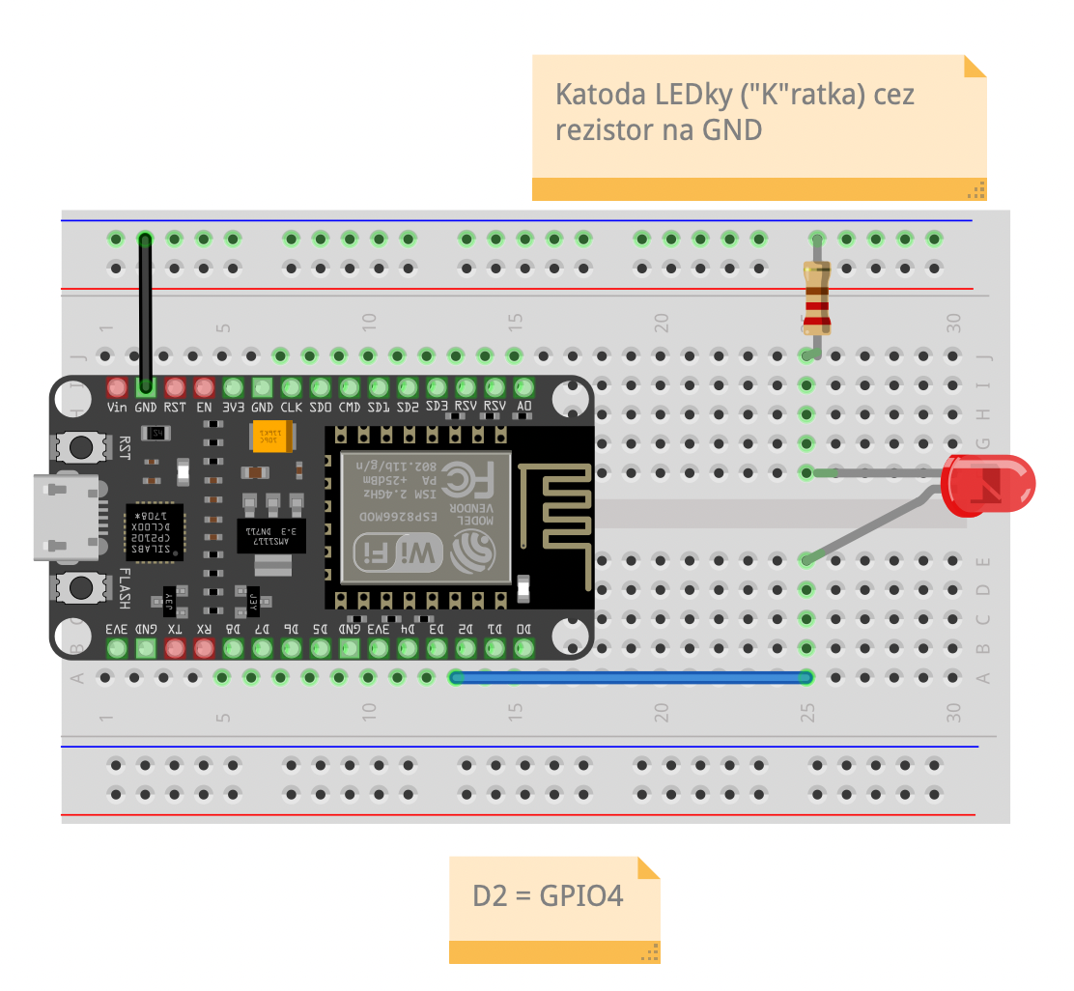
Basics
LED & REPL
$ picocom /dev/tty.usbserial-0001 -b115200
> import time
> from machine import Pin
> onboard_led = Pin(4, Pin.OUT)
> onboard_led.off()
> onboard_led.on()
> while True:
> time.sleep(0.5)
> onboard_led.off()
> time.sleep(0.5)
> onboard_led.on()
> CRTL+A+X (exit picocom)

Slide 15
Basics
IR Sensor & REPL
$ picocom /dev/tty.usbserial-0001 -b115200
> import time
> from machine import Pin
> # 0 is “on” > ir_sensor = Pin(4, Pin.IN)
> # onboard led is reverted
> onboard_led = Pin(2, Pin.OUT)
> while True:
> if not ir_sensor.value():
> onboard_led.off()
> else:
> onboard_led.on()

Slide 16
Basics
Sound sensor & REPL
$ picocom /dev/tty.usbserial-0001 -b115200
> import time
> from machine import Pin
> # 0 is “on” > snd_sensor = Pin(4, Pin.IN)
> # onboard led is reverted
> onboard_led = Pin(2, Pin.OUT)
> while True:
> if not snd_sensor.value():
> onboard_led.off()
> else:
> onboard_led.on()

Slide 17
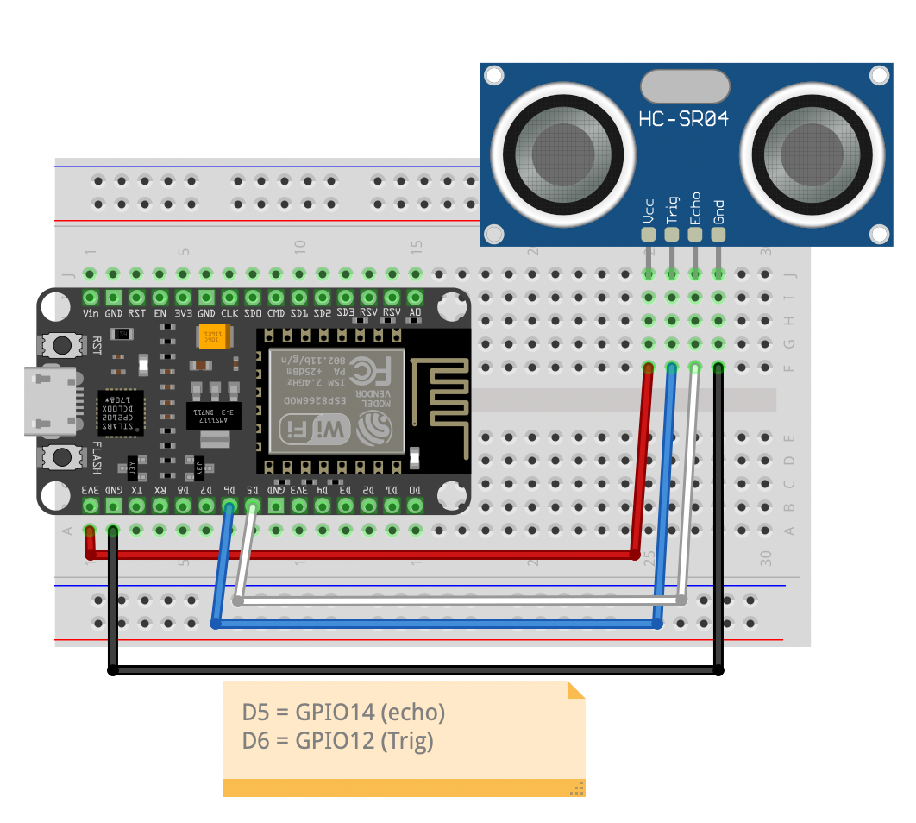
Basics
Distance sensor & REPL
$ picocom /dev/tty.usbserial-0001 -b115200
> from hcsr04 import HCSR04
> # HCSR04(trigger, echo)
> dist_sen = HCSR04(12, 14)
> while True:
> print(dist_sen.distance_cm())
>

Slide 18
Basics
Temperature sensor DS18B20 & REPL
$ picocom /dev/tty.usbserial-0001 -b115200
> import onewire
> import time, ds18x20
> from machine import Pin
> ow = onewire.OneWire(Pin(4))
> ds = ds18x20.DS18X20(ow)
> roms = ds.scan()
> while True:
> ds.convert_temp()
> time.sleep_ms(750)
> for rom in roms:
> print(ds.read_temp(rom))

Slide 19
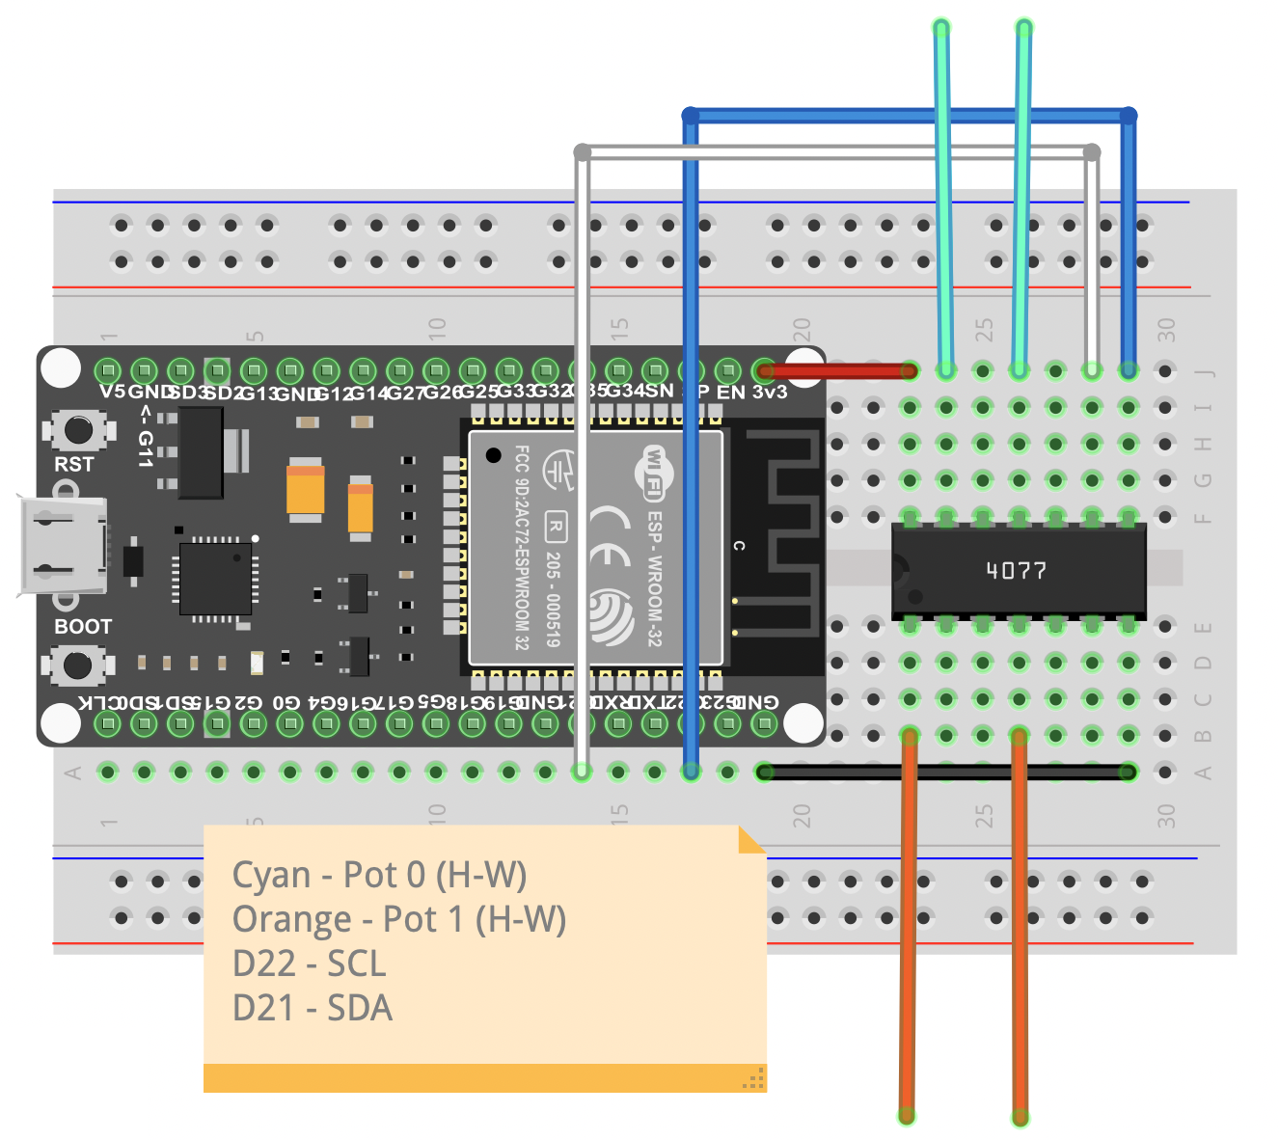
Basics
DS1803 Digital Potentiometer
I2C – Inter-Integrated Circuit
SDA – data wire
SCL – clock wire
Datasheet
DS1803 helper class
$ picocom /dev/tty.usbserial-0001 -b115200
> from ds1803 import DS1803
> ds = DS1803()
> ds.set_pot0_value(100) # 0 - 255
> ds.get_pot0_value() # return value of pot0

Slide 20
Basics
Connect Wi-Fi
$ picocom /dev/tty.usbserial-0001 -b115200
> import network
> def connect_wifi(ssid, key):
> wlan = network.WLAN(network.STA_IF)
> wlan.active(True)
> if not wlan.isconnected():
> print('connecting to network...’)
> wlan.connect(ssid, key)
> while not wlan.isconnected():
> pass
> print('network config:', wlan.ifconfig())
>
> connect_wifi(“SSID”, ”PWD”)

Slide 21
Basics
MQTT - Subscribe
$ picocom /dev/tty.usbserial-0001 -b115200
> import time
> from umqtt.simple import MQTTClient
>
> def msg_callback(topic, msg):
> print(topic, msg)
>
> client = MQTTClient(”esp_1”,”node02.myqtthub.com”, ssl=False, user=“esp_1”, password=“PyConSK2022”)
> client.set_callback(msg_callback)
> client.connect() # might fail
> client.subscribe(“esp_1/led”)
>
> while True:
> client.check_msg() # client.wait_msg() blocking
> time.sleep(1)

Slide 22
Basics
MQTT - Publish
$ picocom /dev/tty.usbserial-0001 -b115200
> import time
> from umqtt.simple import MQTTClient
>
> client = MQTTClient(”esp_1”,”node02.myqtthub.com”, ssl=False, user=“esp_1”, password=“PyConSK2022”)
> client.set_callback(msg_callback)
> client.connect() # might fail
>
> client.publish(“esp_1/temp”, “25”)
Samples
https://github.com/micropython/micropython-lib/tree/master/micropython/umqtt.simple

Slide 23
Basics
MQTT_AS – Async version
Non-blocking MQTT
https://github.com/peterhinch/micropython-mqtt/tree/master/mqtt_as
Build FW with mtqq_as
https://github.com/micropython/micropython/tree/master/ports/esp8266
Sample
IR Sensor with MQTT

Slide 24
Basics
Uploading Files
Uploading Files
https://pythonforundergradengineers.com/upload-py-files-to-esp8266-running-micropython.html
(close other serial connections before – CRTL+A+X for picocom)
$ ampy --help
$ ampy --port /dev/tty.usbserial-0001 --baud 115200 ls
$ ampy --port /dev/tty.usbserial-0001 --baud 115200 put boot.py
Boot.py
Run on boot
Main.py
Main module, run after boot

Slide 25
Basics
Back-end side (Raspberry Pi)
Docs
https://www.raspberrypi.com/documentation/
Connect
ssh pi@raspberrypi.local (pwd: PyConSK2022)
Config
sudo raspi-config
Paho MQTT
https://pypi.org/project/paho-mqtt/
Async MQTT
https://github.com/sbtinstruments/asyncio-mqtt

Slide 26
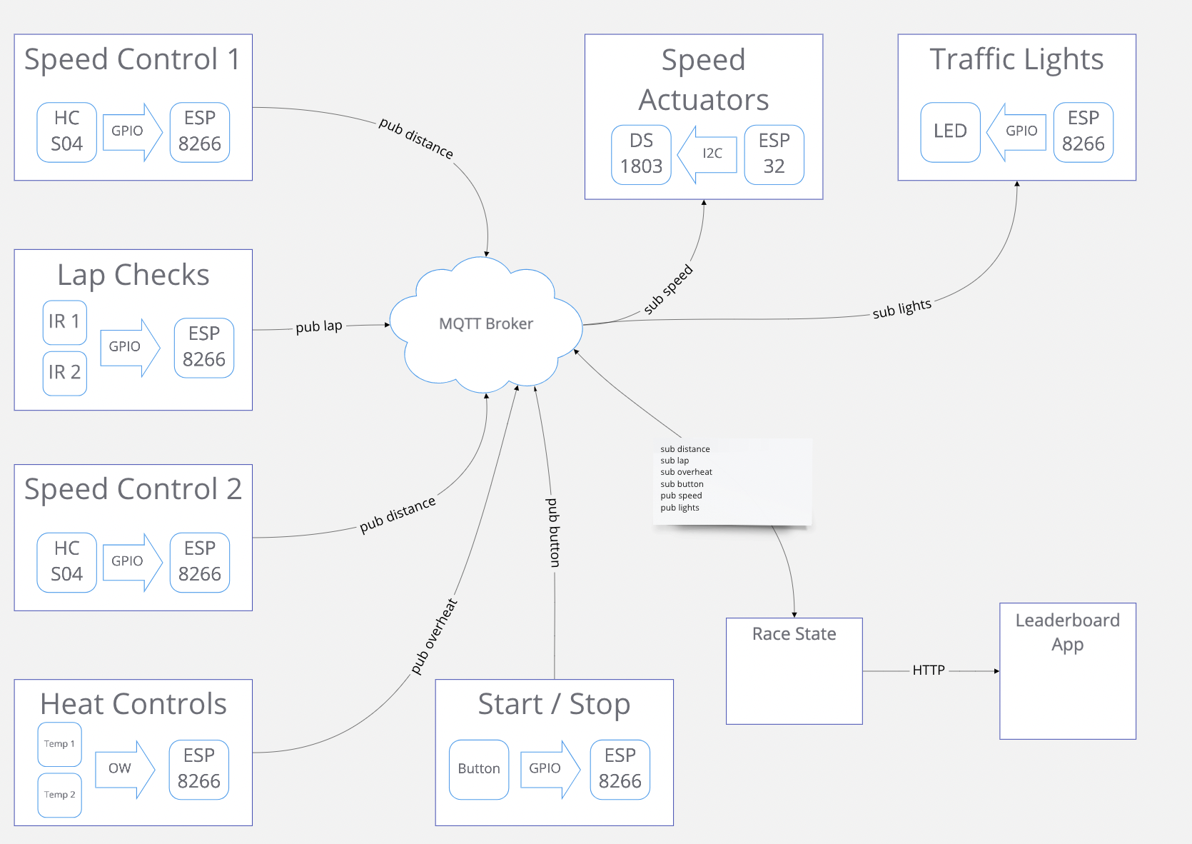
Workshop
IoT Race Track
Carrera Race Track
ESP8266 6x
ESP32 2x
HC S04 2x
IR 2x
Temp Sensor 2x
DS1803
LEDs
Button
RaspberryPi

Slide 27
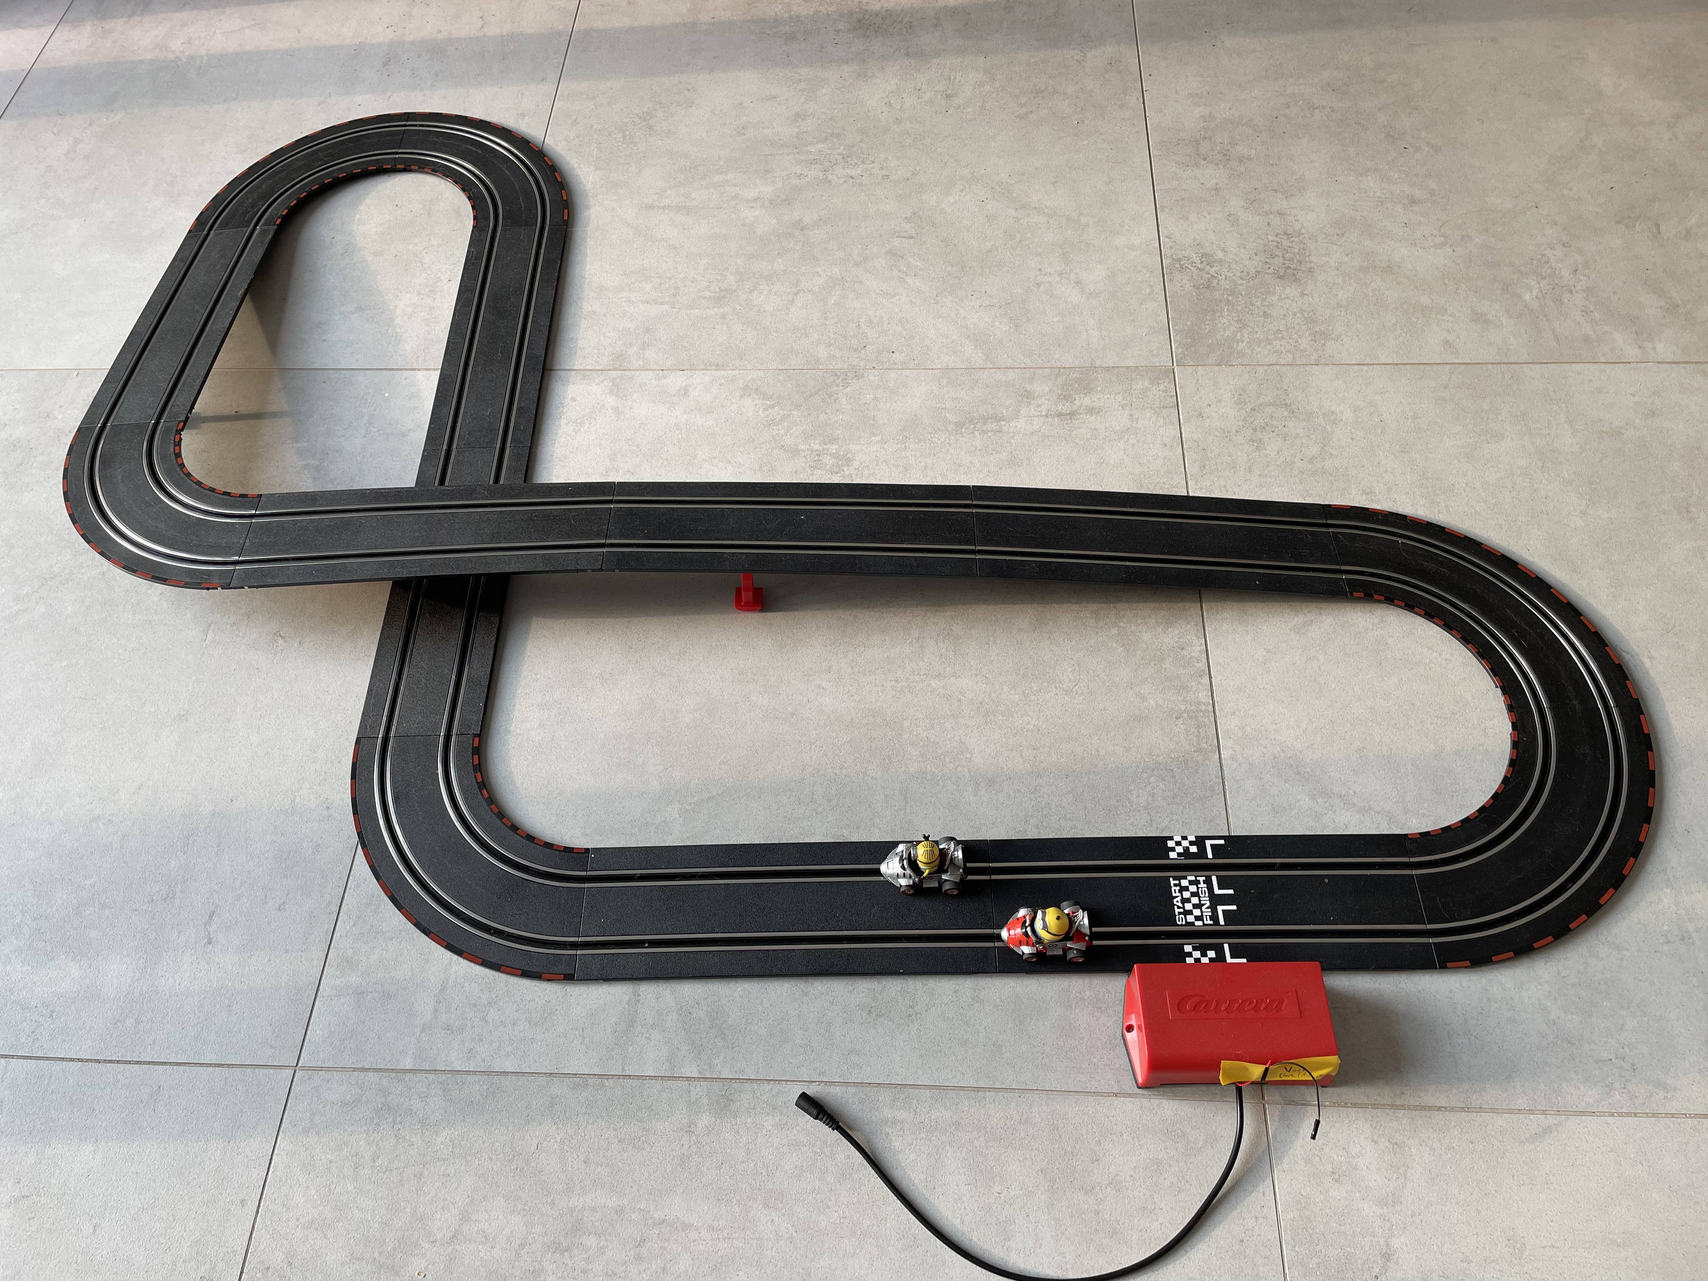
Workshop
Racetrack
Standard racetrack
Speed based on potentiometer value
9V input

Slide 28
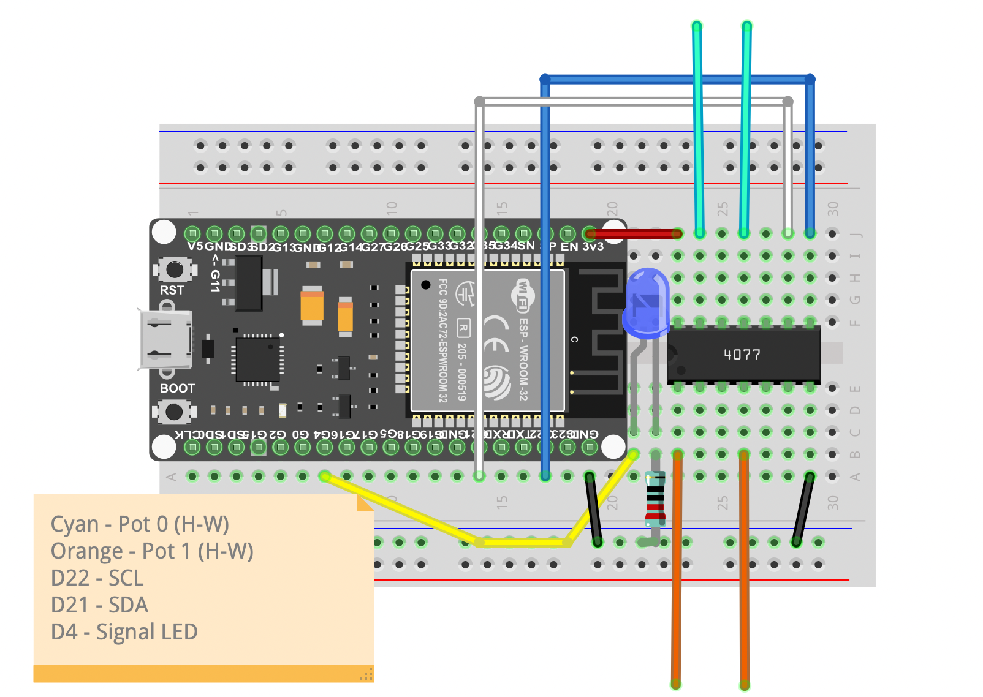
Workshop
Speed Actuator with DS1803
Control speed
Sub to racetrack/speed
Accept: { „track“: 0/1, „speed“: value}
Sample Code
Schematic

Slide 29
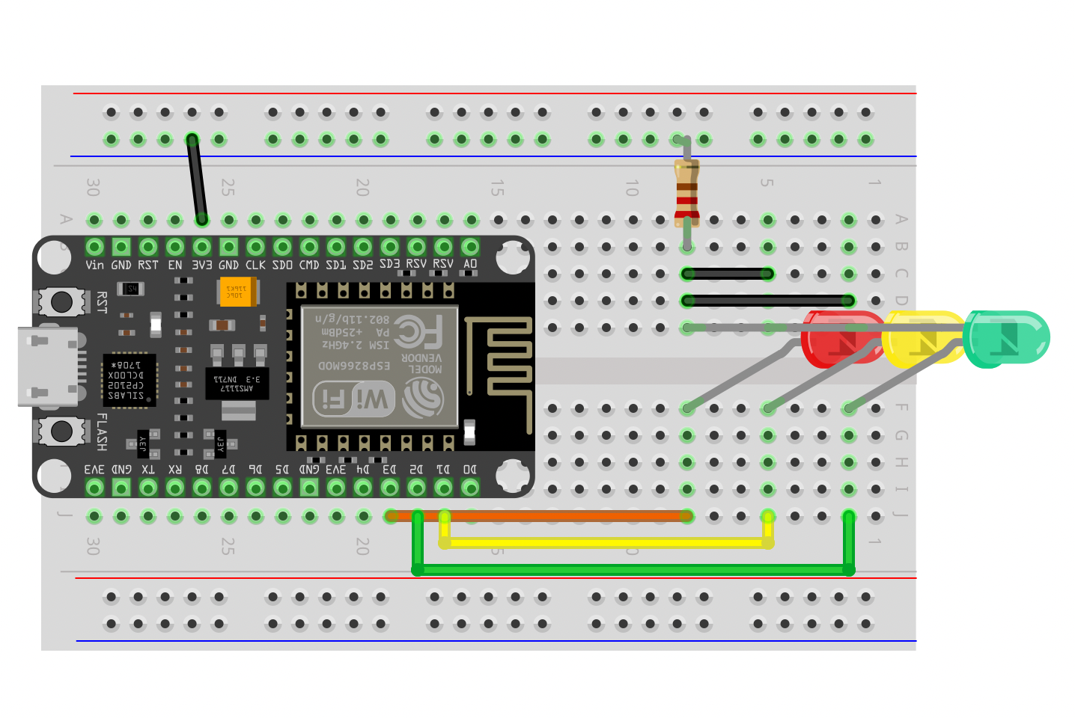
Workshop
Traffic Lights
Signal track state
Sub to racetrack/lights
Accept: { „command“: <cmd> }
cmd
rsg – starting race
blink_red – idle state
…just anything
Sample Code
Schematic

Slide 30
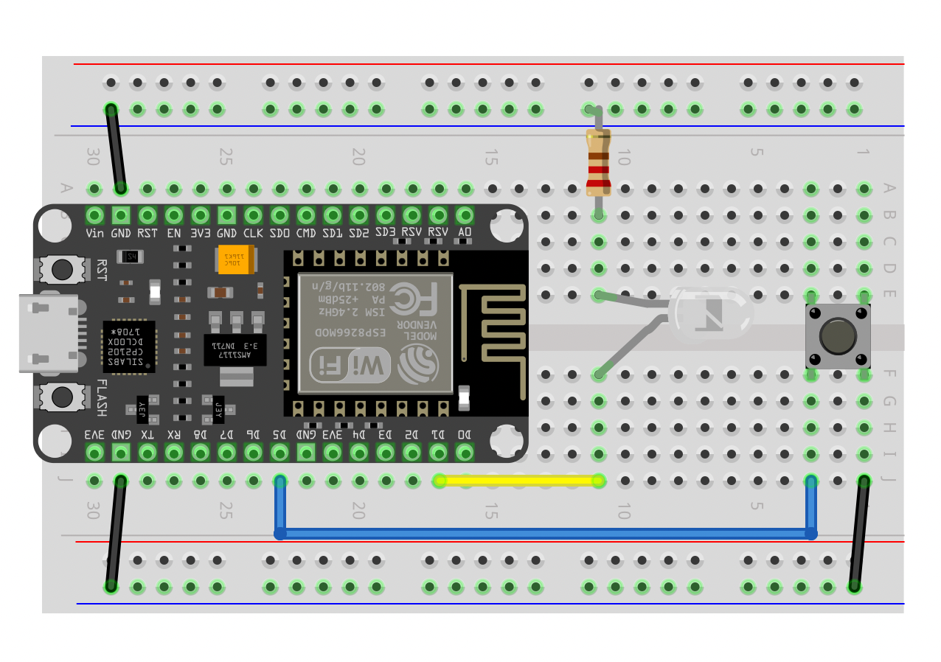
Workshop
Button
Sets the racetrack state
Pub to racetrack/button
Msg: { „time“: <time_released>}
Sample Code
Schematic

Slide 31
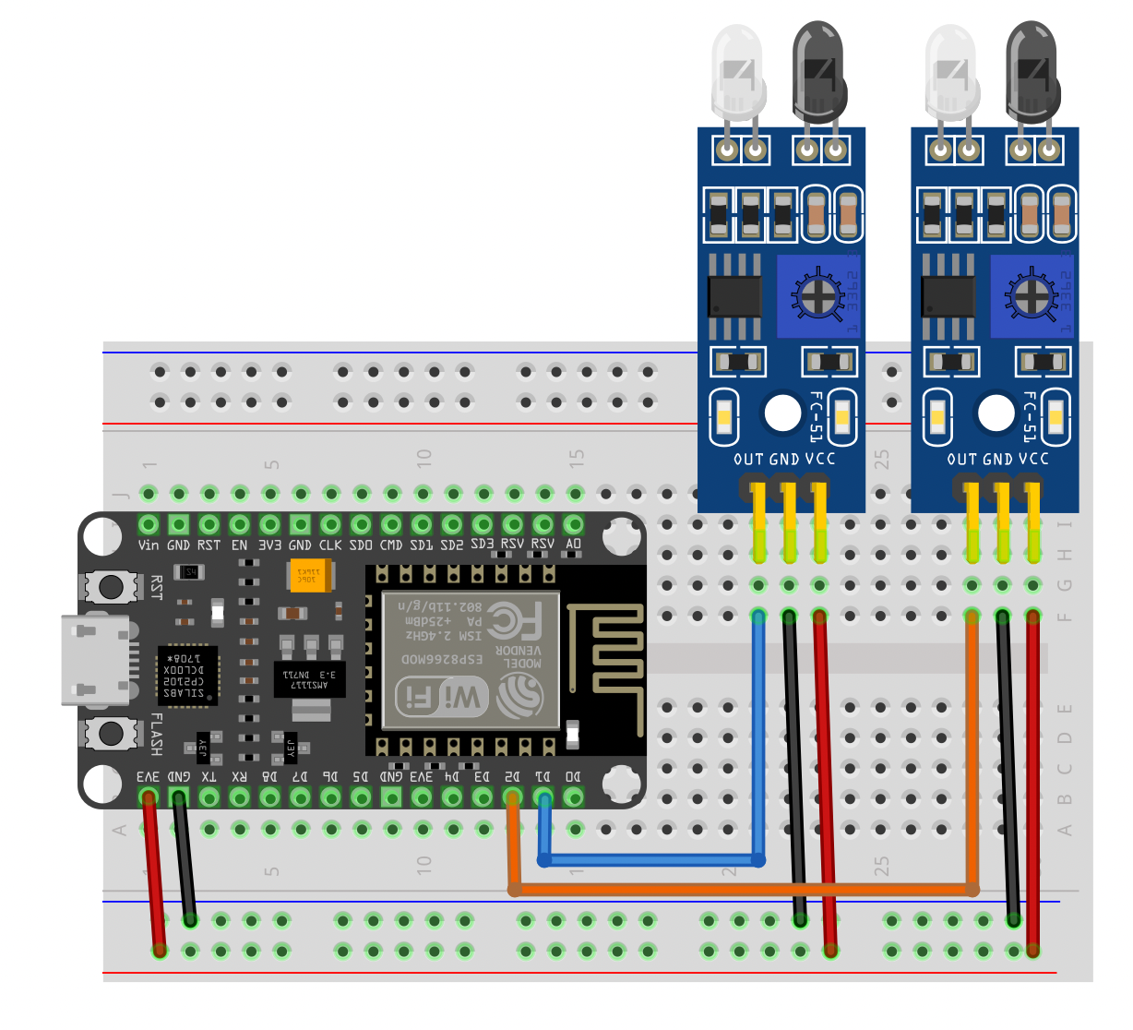
Workshop
Lap Check
Notifies lap done
Pub to racetrack/lap
Msg: { „track“: <0/1>, „lap“: <time>}
Sample Code
Schematic

Slide 32
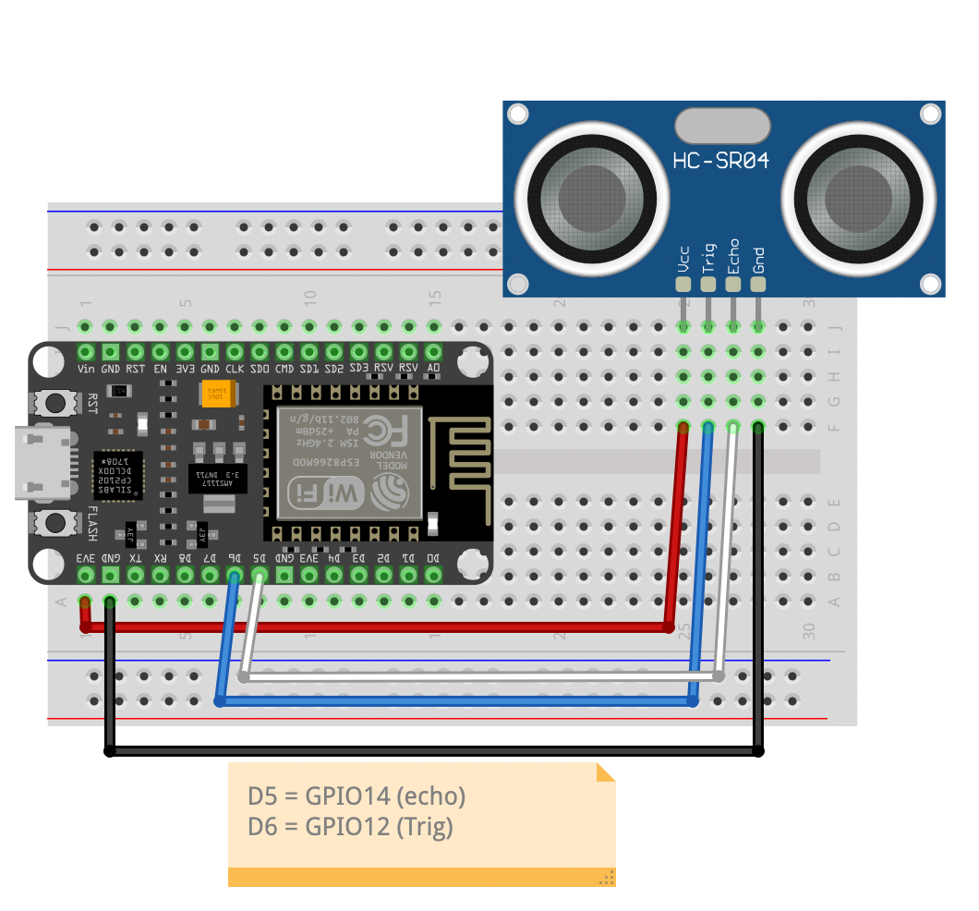
Workshop
Speed Control
Control speed
Racetrack „brain“ translates dist -> speed
Pub to racetrack/distance
Msg: { „track“: <0/1>, „distance“: <dist_in_cm>}
Sample Code
Schematic

Slide 33
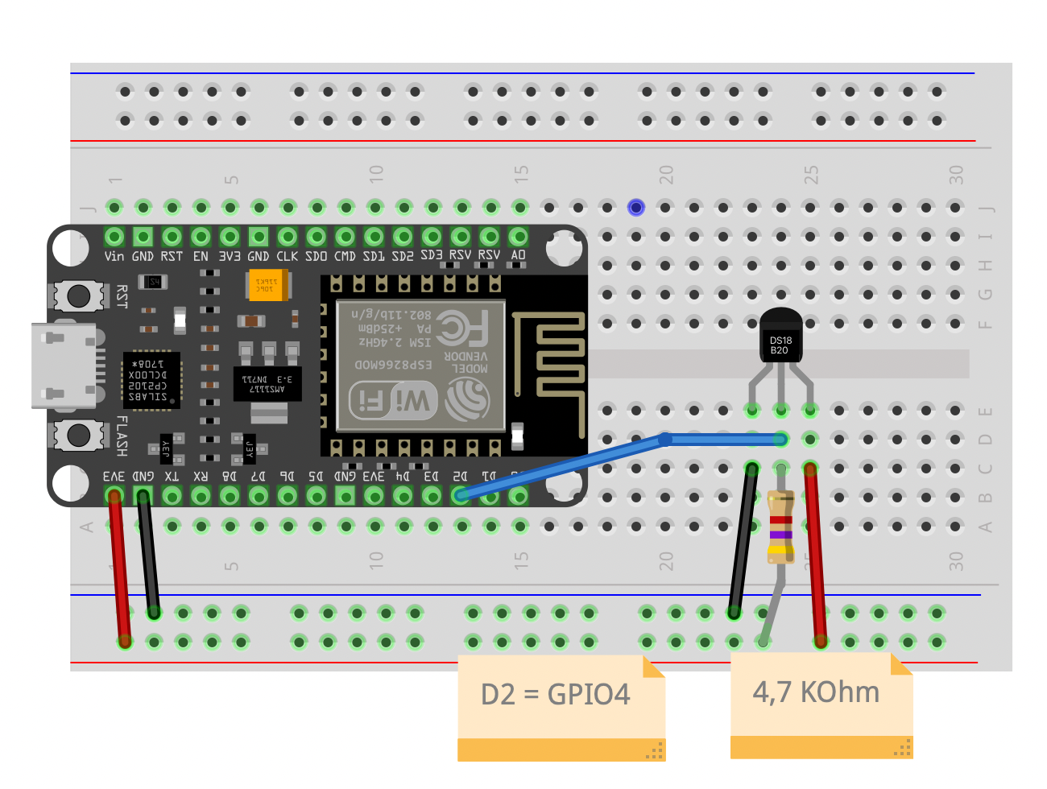
Workshop
Overheat
Cripple speed
Racetrack „brain“ lowers speed
Pub to racetrack/overheat
Msg: { „track“: <0/1>, „temp“: <temp_in_C>}
Sample Code
Schematic

Slide 34

Workshop
Racetrack state on RaspberryPi
Async MQTT
State
Idle / Running
Track # of laps
Track overheated status for track
Subscribe
Distance, lap, overheat, button
Publish
Speed, lights, sync time
Code

Slide 35

Workshop
Leaderboard API
Simple FastAPI App
Score model
time, name, created
/leaderboard/
GET list of Scores
/leaderboard/
POST new score {“time“: <seconds>}
/leaderboard/{score_id}
PATCH score with name {„name“: <player_name>}
Code

Slide 36

Workshop
Leaderboard Front End
Simple React App
Simple Name – Time Table
Poll /leaderboard/ endpoint every 2 seconds
Check for new scores (without name)
Show form to enter name when new score found
PATCH score with name
Code

Slide 37
LINKS
ESP2866
https://www.espressif.com/en/products/socs/esp8266
MicroPython
https://micropython.org/
MQTT
https://mqtt.org/
MQTT vs. HTTP
Github
https://github.com/michael-niepel-exxeta/pycon-sk-2022-esp8266

